Slide 1
12. Market Cap and Number of Blockchain Nodes/Validators

Slide 2
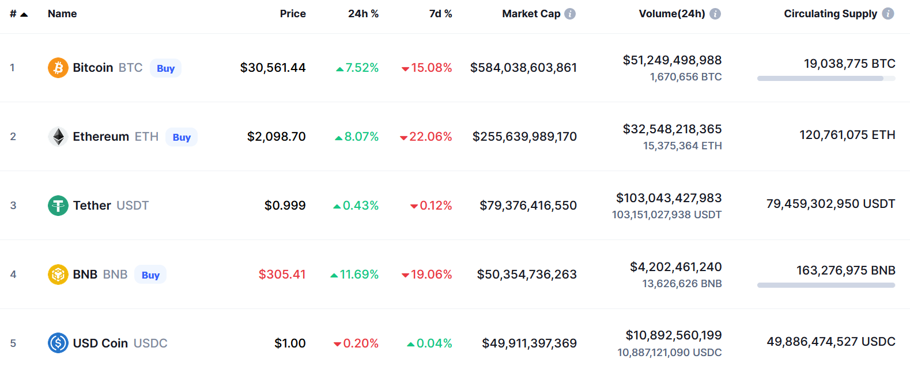
Market Cap (1/4)
https://coinmarketcap.com/
(As of 2022/05/13)

Slide 3
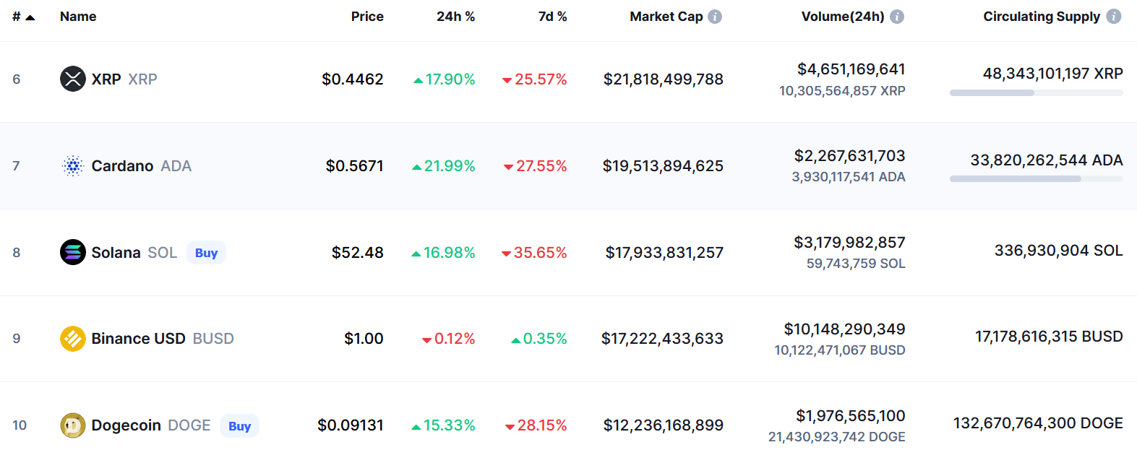
Market Cap (2/4)
(As of 2022/05/13)

Slide 4
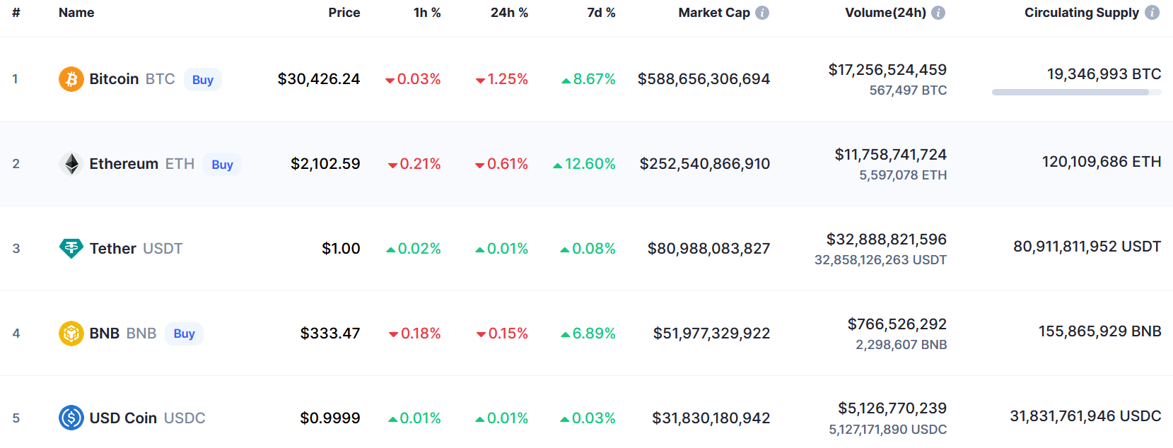
Market Cap (3/4)
(As of 2023/04/15)

Slide 5
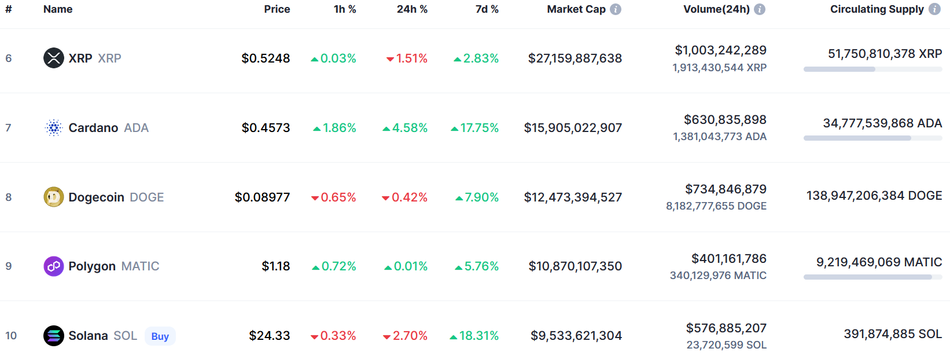
Market Cap (4/4)
(As of 2023/04/15)

Slide 6
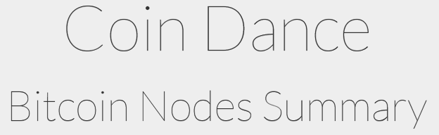
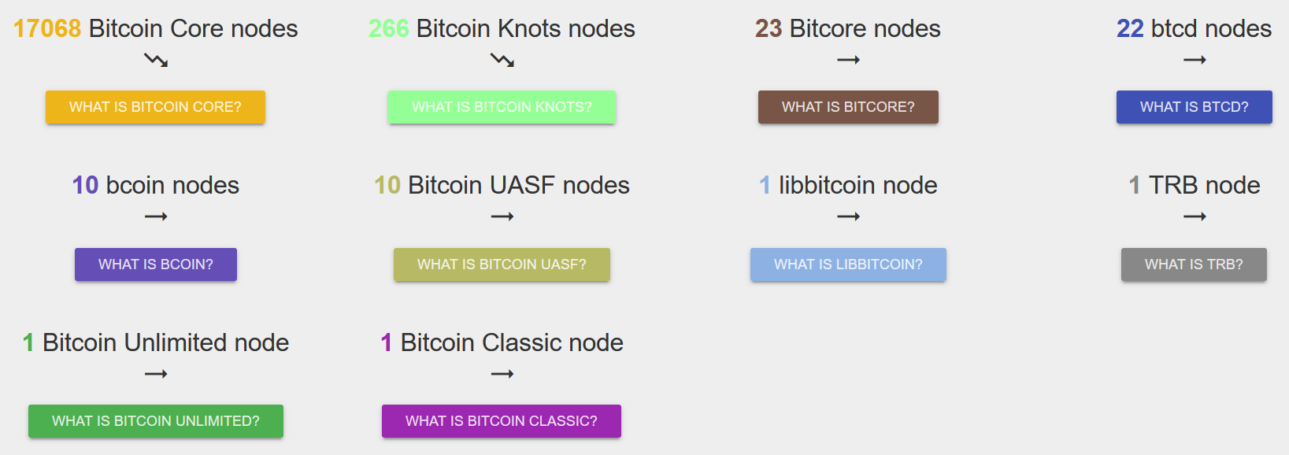
Bitcoin Nodes
https://coin.dance/nodes#share
(As of 2023/04/15)

Slide 7
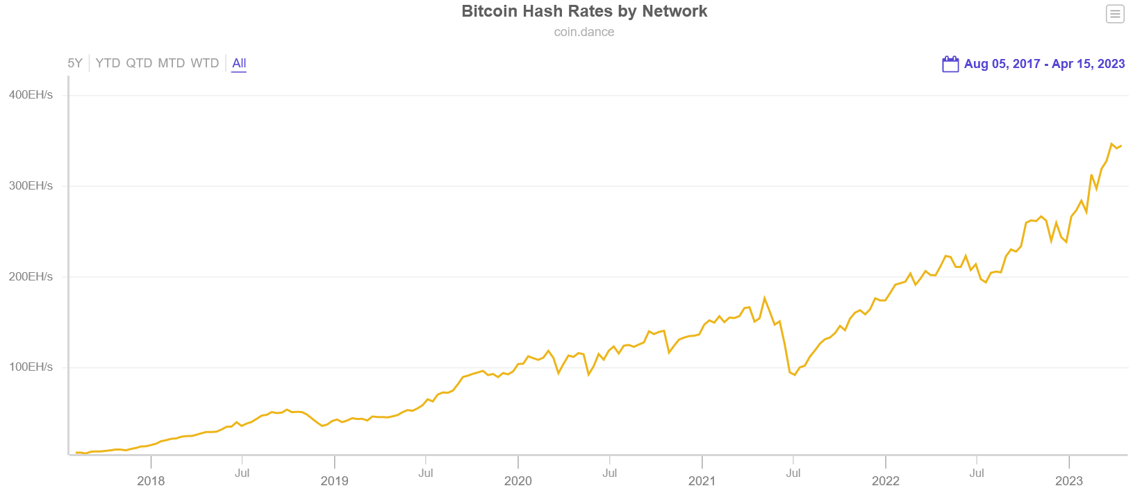
Bitcoin Hash Rates
Exa Hashes per second (EH/s), which equals one Quintillion (10¹⁸) hashes.

Slide 8
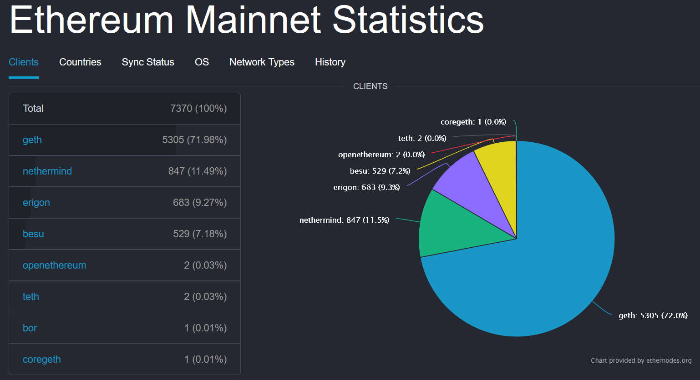
Ethereum Clients
https://ethernodes.org/
(As of 2023/04/14)

Slide 9
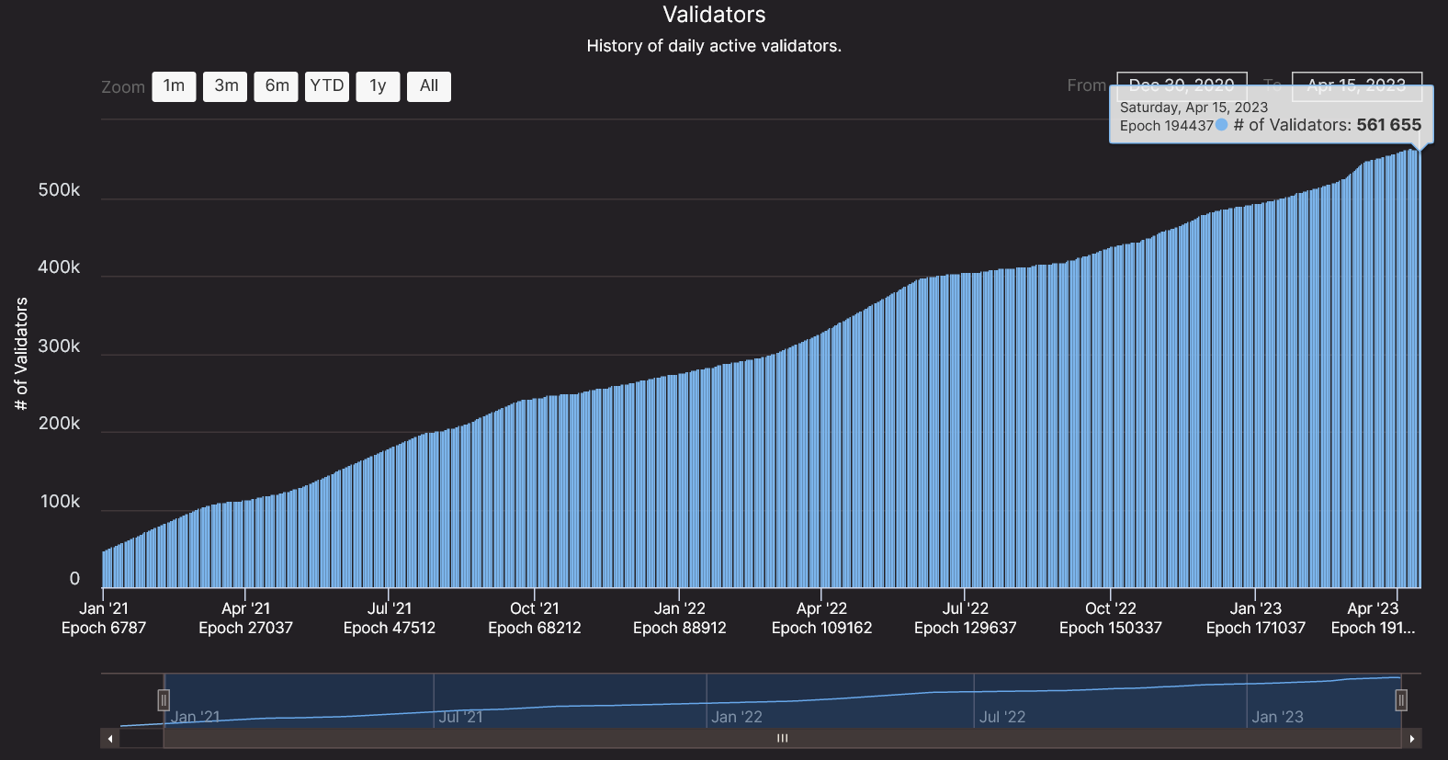
Ethereum 2.0 Validators
https://beaconcha.in/charts/validators
The Merge was executed on September 15, 2022

Slide 10
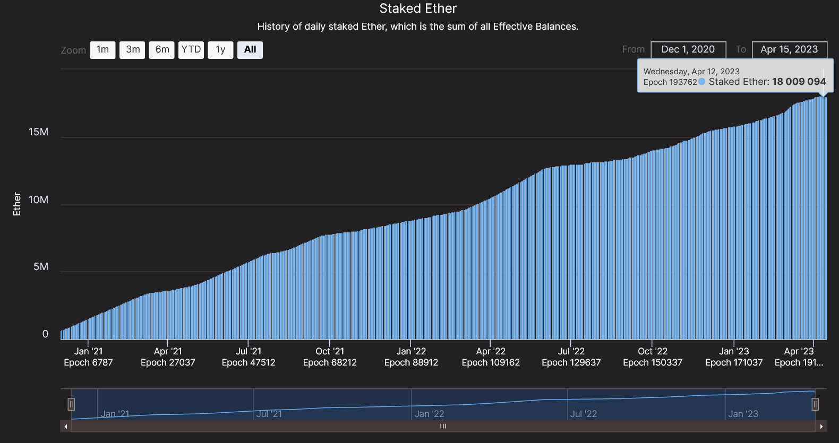
Staked Ether
https://beaconcha.in/charts/staked_ether
The ratio of staked ether to the coin's total supply ≈ 15%

Slide 11
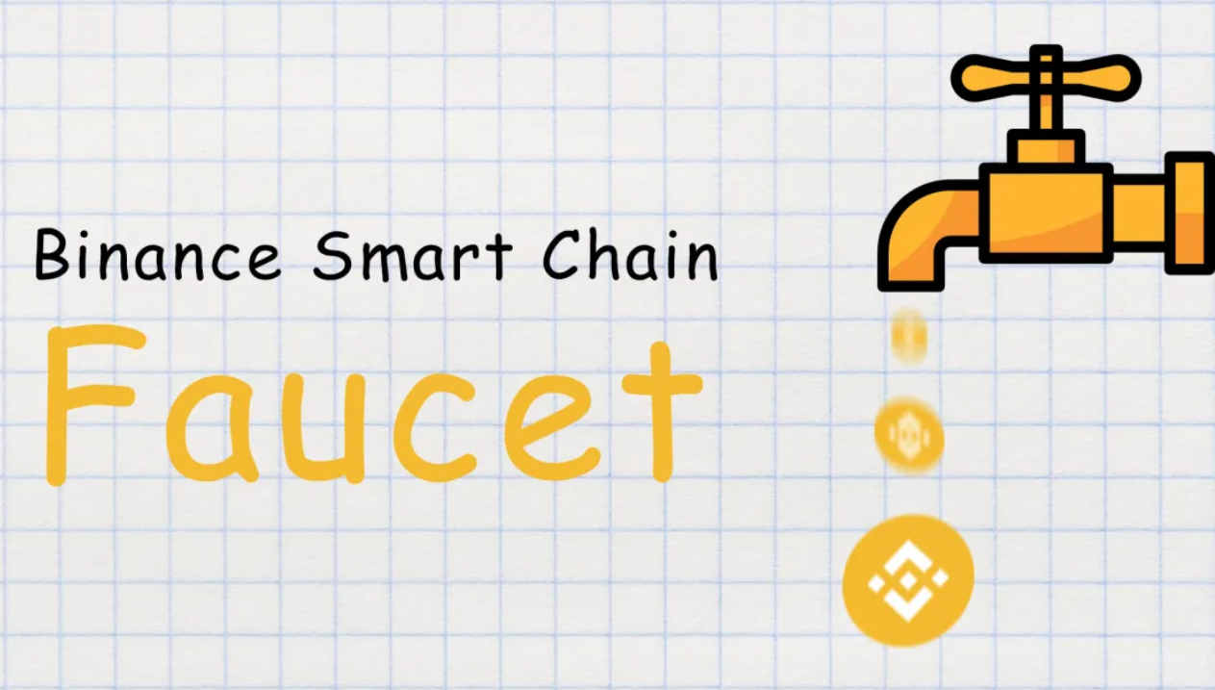
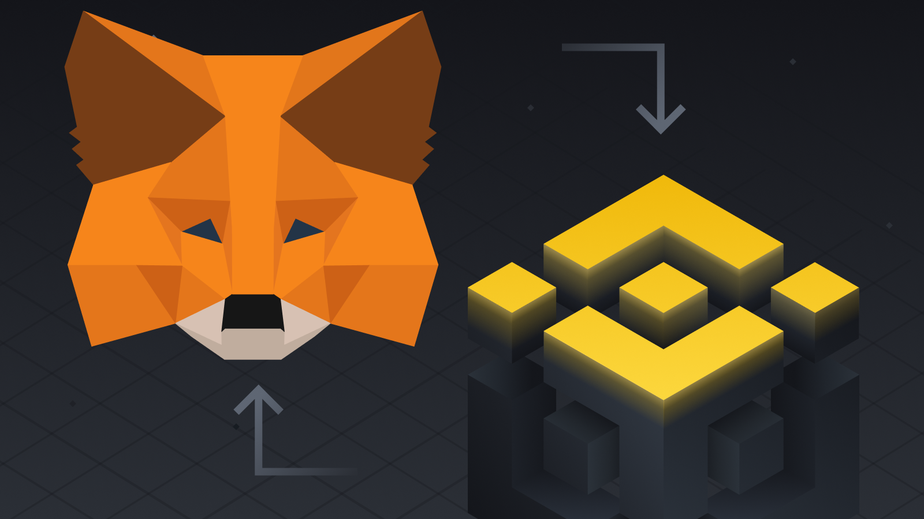
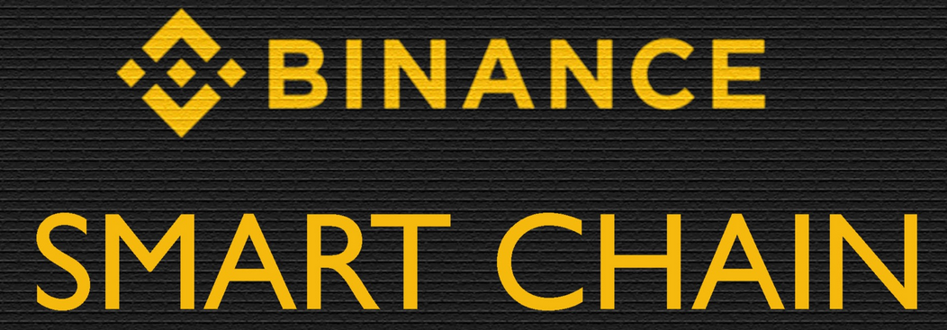
Binance Smart Chain
(More like a centralized Ethereum)
BNB: Binance Coin
Binance Smart Chain supports EVM-compatible smart contracts and protocols.
Binance Smart Chain relies on a system of 21 validators with Proof of Staked Authority (PoSA) consensus that can support short block time and lower fees.

Slide 12
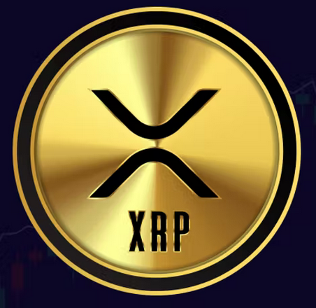
Ripple (XRP) (1/3)
https://xrpl.org/intro-to-consensus.html
The core principle behind the XRP Ledger's consensus mechanism is that a little trust goes a long way.
Each participant in the network chooses a set of validators, servers specifically configured to participate actively in consensus, run by different parties who are expected to behave honestly most of the time according to the protocol.
The core server, rippled, runs the peer-to-peer network which processes transactions and reaches a consensus on their outcome. An XRPL validator is a rippled server running in validator mode.
The set of chosen validators should not be likely to collude with one another to break the rules in the exact same way. This list is called a Unique Node List, or UNL.

Slide 13
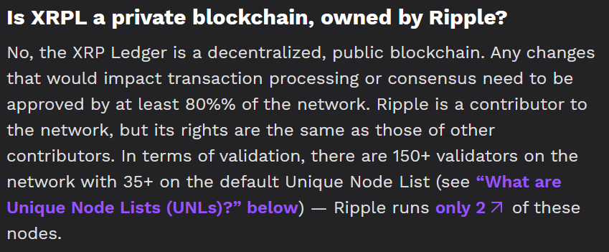
Ripple (XRP) (2/3)
As the network progresses, each server listens to its trusted validators; as long as a large enough percentage of them agree that a set of transactions should occur and that a given ledger is the result, the server declares a consensus.
If they don't agree, validators modify their proposals to more closely match the other validators they trust, repeating the process in several rounds until they reach a consensus.

Slide 14
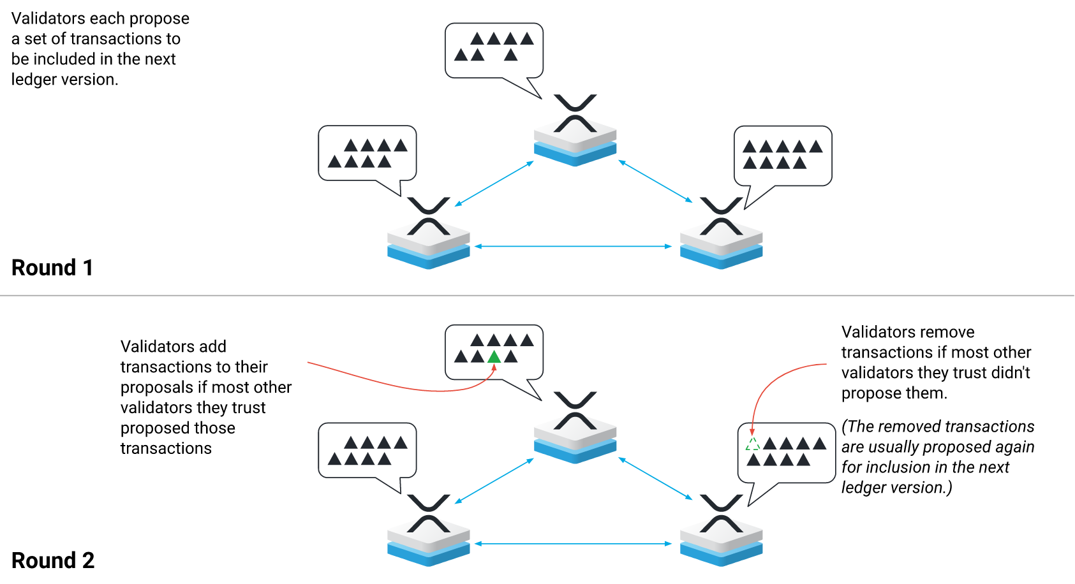
Ripple (XRP) (3/3)

Slide 15
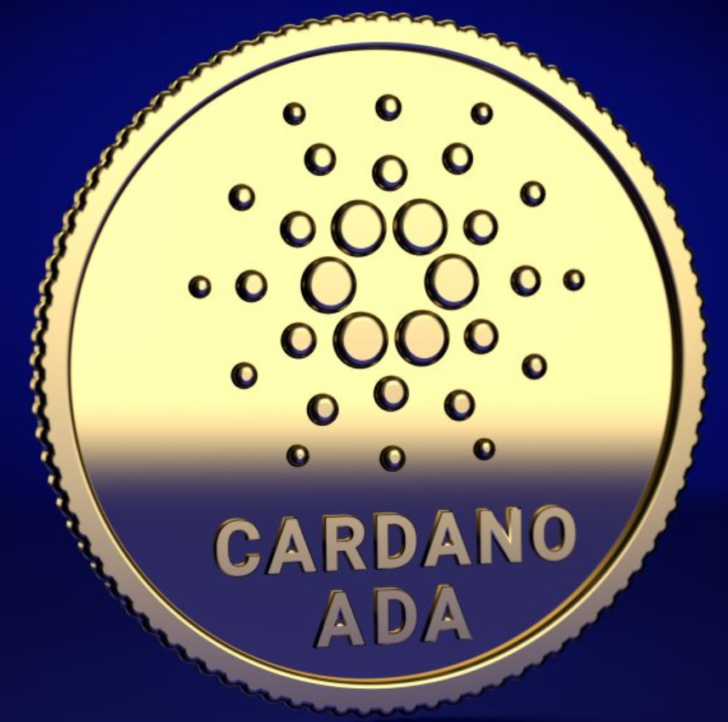

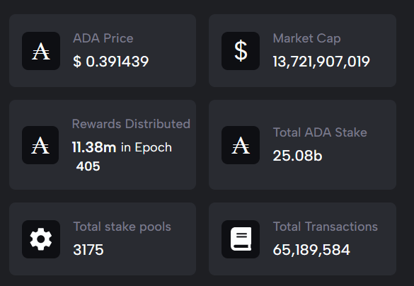
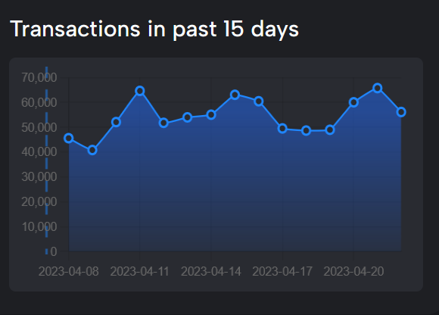
Cardano (ADA)
https://cardanoscan.io/
Proof-of-Stake
(As of 2023.4.23)

Slide 16
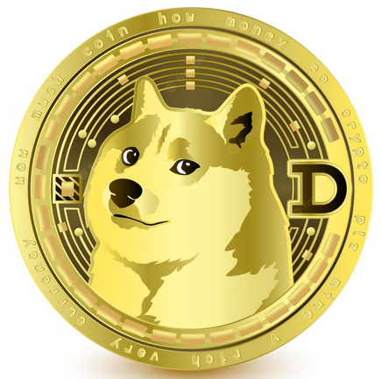
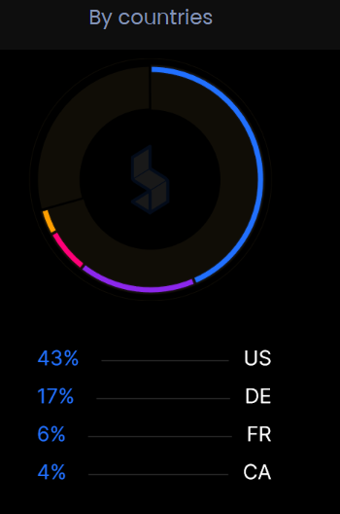
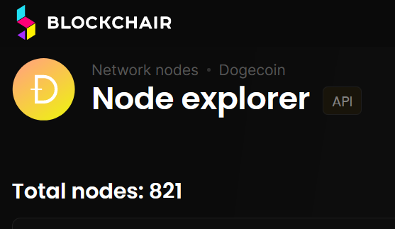
Dogecoin (DOGE)
Second largest Proof-of-Work blockchain after Ethereum Merge
(As of 2023.4.23)
https://blockchair.com/dogecoin/nodes

Slide 17
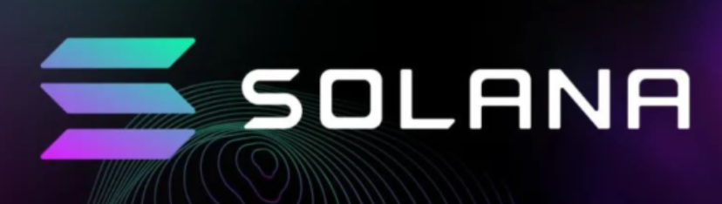
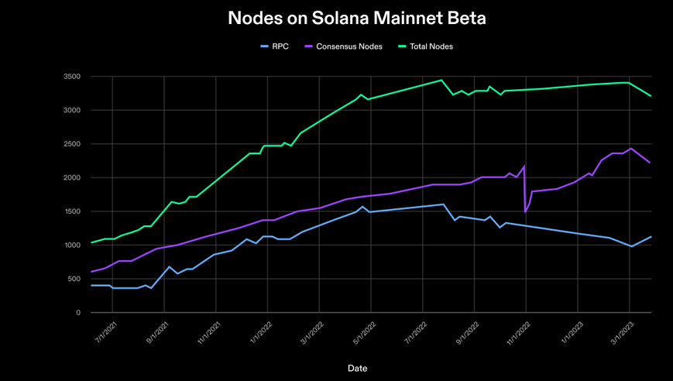
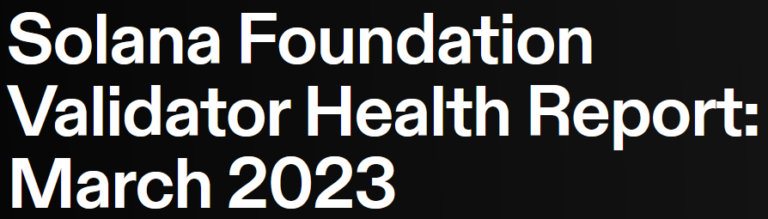
Solana (SOL)
The Solana mainnet beta network went live in March 2020. Since then, it’s grown into a network of over 3,400 validators, including over 2,400 consensus nodes (Proof-of-Stake).
https://solana.com/news/validator-health-report-march-2023

Slide 18
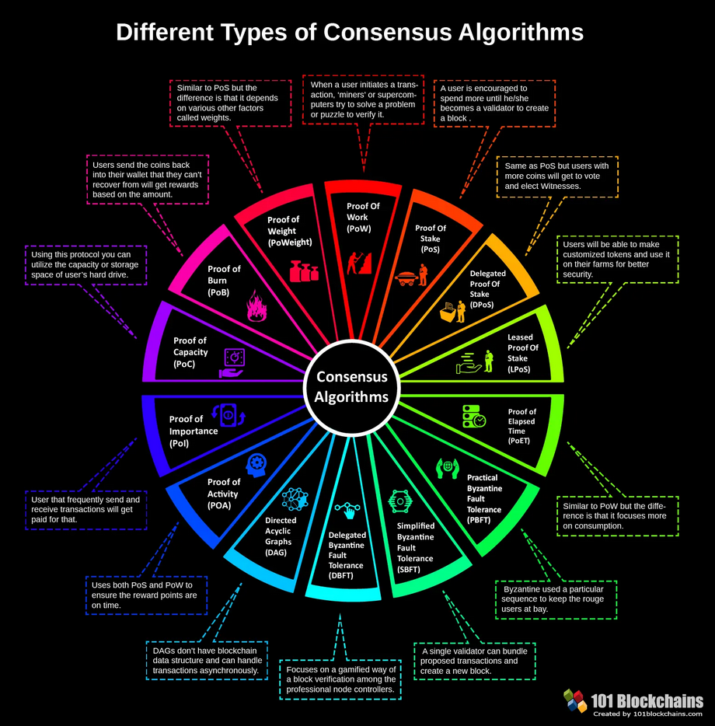
https://101blockchains.com/consensus-algorithms-blockchain/

